Slide 1



HexxCode
College of Engineering Pune
SIH 1465
A unified portal for developing a model Curriculum for all the AICTE Approved Institutes
View our Code on GitHub https://github.com/pt3002/HexxCode-SIH-2023

Slide 2


Agenda
01
02
03
04
05
06
07
08
Problem Statement
Block Diagram vs Tech Stacks Structure Hierarchy
Phases
Capabilities
Solution Approach
Future Goals
Team

Slide 3






“We acknowledge the Problem Statement and Purpose for the Hackathon”
Educational Stakeholders
Problem Statement
Purpose
Design Model Curriculum
A Unified Portal to collaborate across educational stakeholders to formulate and maintain curriculum standards for Technical Education in India
Collaboration
Personification
Intuitive & Interactive Development
Resource Repository
Transparency

Slide 4
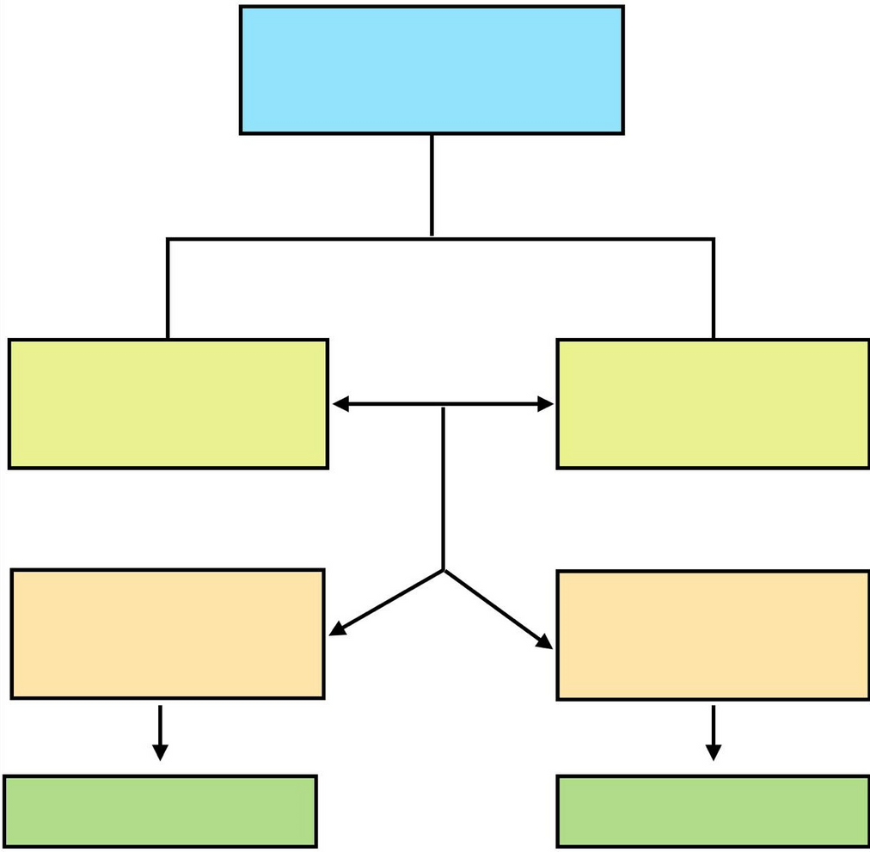
“The Portal Building Blocks and Architecture are developed using latest technologies”
FrontEnd
Web Portal
REACT JS
Role Management System
Registration & Personification
SQL
AWS SES
Content
Repository
Collaborative
Tools
MongoDB
Version Control
Security
Work Flow Manager
AWS
APIs

Slide 5


Frameworks
ChartJS
PDF-Viewer
Json Web Token
Libraries
Front-end
React
MUI
Database
AWS SQL
MongoDB
Back-end
Express
Node
Python

Slide 6




Structure Hierarchy
AICTE ADMIN
Feedback
INDUSTRY
EXPERT
BUREAU A
BUREAU C
DEPARTMENT
HEAD (ELEC)
BUREAU B
Approval
CURRICULUM DEVELOPERS

Slide 7





Platform Capabilities & Phases
“Across 3 waves, we will have 15+ Capabilities to offer to its stakeholders”
Phase 1
Phase 2
Phase 3
BUILD THE FOUNDATION
ENABLE FUNCTIONALITIES
INTEGRATE, GOVERN AND TEST
User Registration
Rating Mechanism
AICTE Approval
Authentication
LTP Model
Integration
Resource Repository
Collaboration Tools
Experts Feedback
Enabling Guidelines
Notifications
Graphical Visuals
Discussion Mechanism
Email Services
Analytics

Slide 8




Our Approach
Requirements
Solutions Proposed
User Registration and Authentication
Two step authentication
Mulitple Roles
Dashboard and User Profiles
Personalised dashboard based on their roles
LTP Model
Commenting
Version Control
Curriculum Design Tools
Resource Repository
Merge all CD curriculum
AICTE approved resources

Slide 9




Requirements
Solutions Proposed
Calendar to track group meeting
Subject Wise Group
Discussion Forum
Collaboration
Teachers
Industry Experts
Feedback
Analytics and Reporting
Analysis on feedback data
Curriculum analysis visible to AICTE Admin
Notifications and Updates
Notify users on upload of new guidelines and curriculum by aicte.

Slide 10

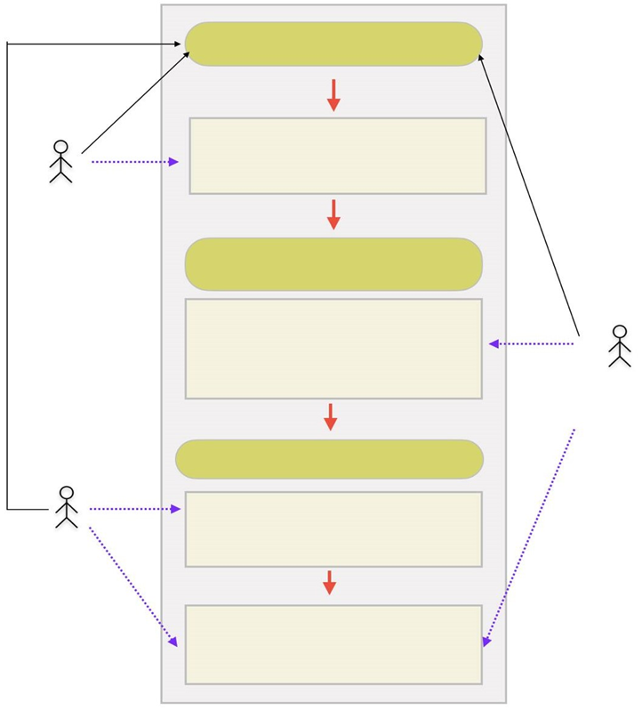

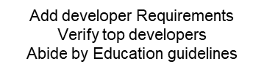








Use Case Diagram

Slide 11

Future Goals
01
AI/ML
Analyzing large feedback
02
Resume Screening
Shortlist Curriculum Developers
03
Curriculum Suggestions
Automate task for Curriculum Developer
04
#विकसितभारत
awareness about and track the implementation of flagship central schemes

Slide 12
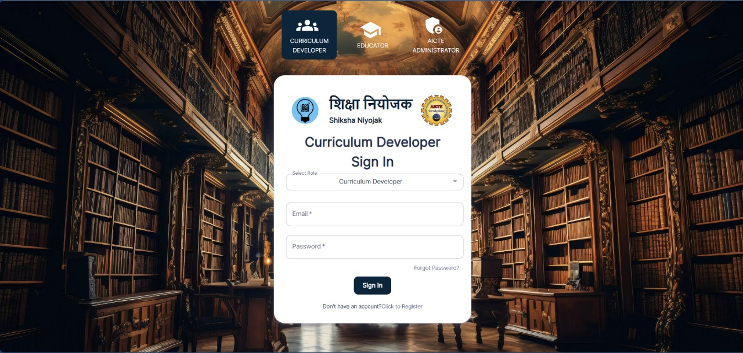
Login Page

Slide 13



Curriculum Developer Pages
Personalised Dashboard
LTP (Lecture, Tutorial, Practical) Model
Curriculum Development Tool
Version Control
Calendar
Discussion Forum

Slide 14
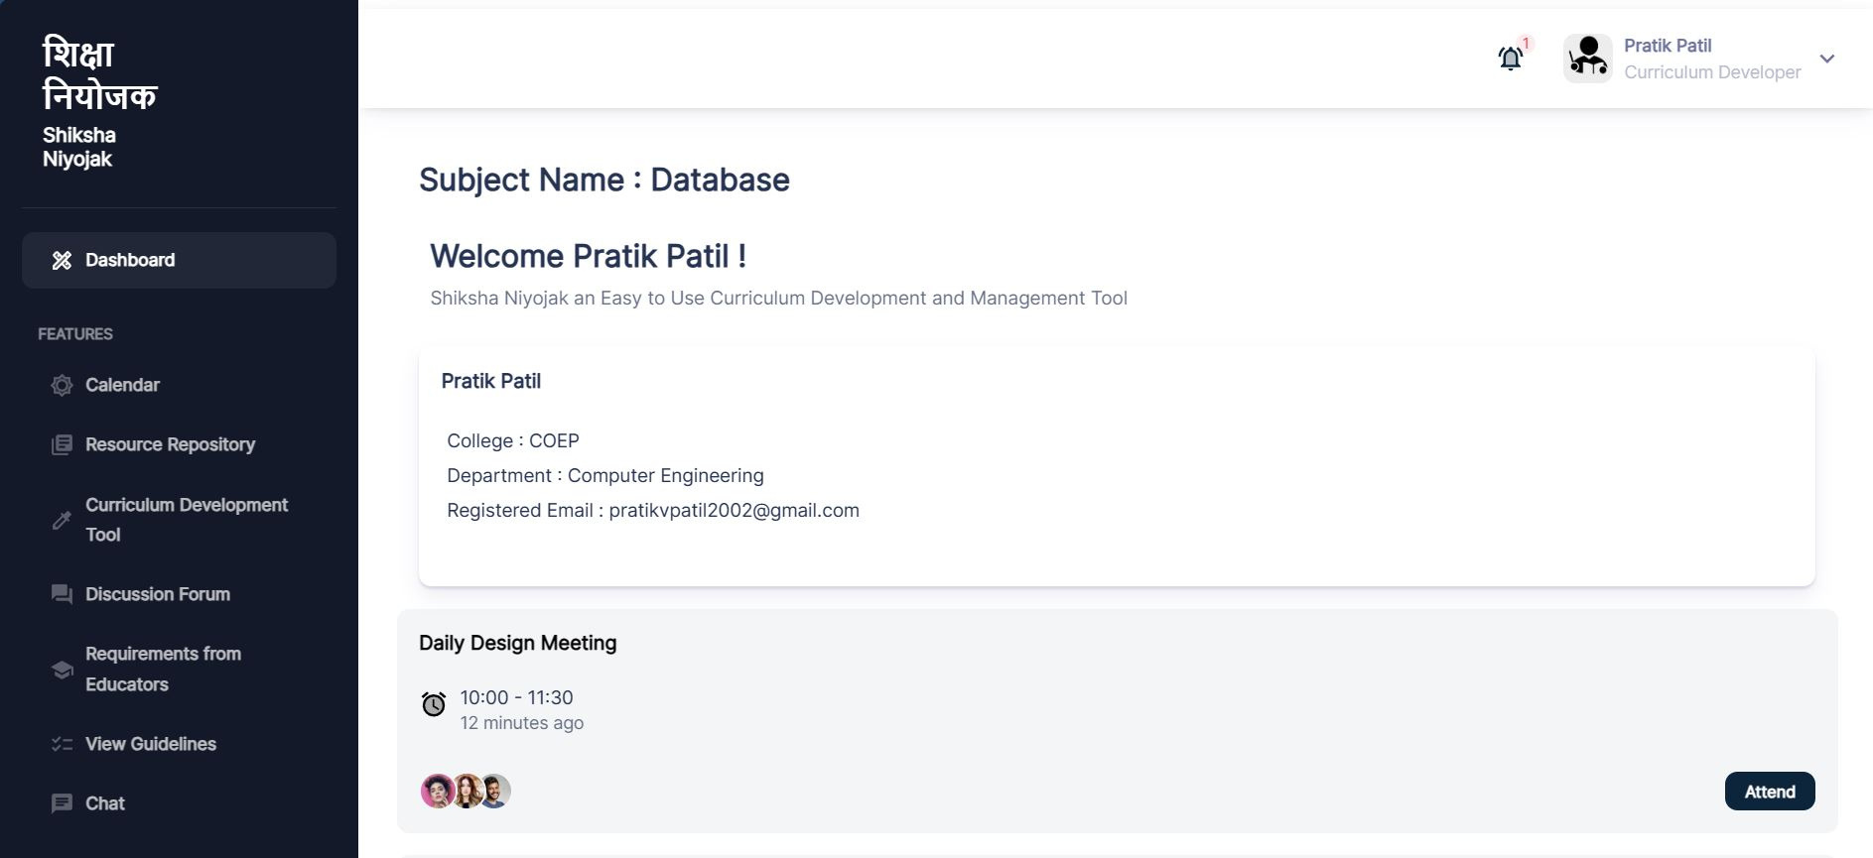
Personalized Dashboard

Slide 15
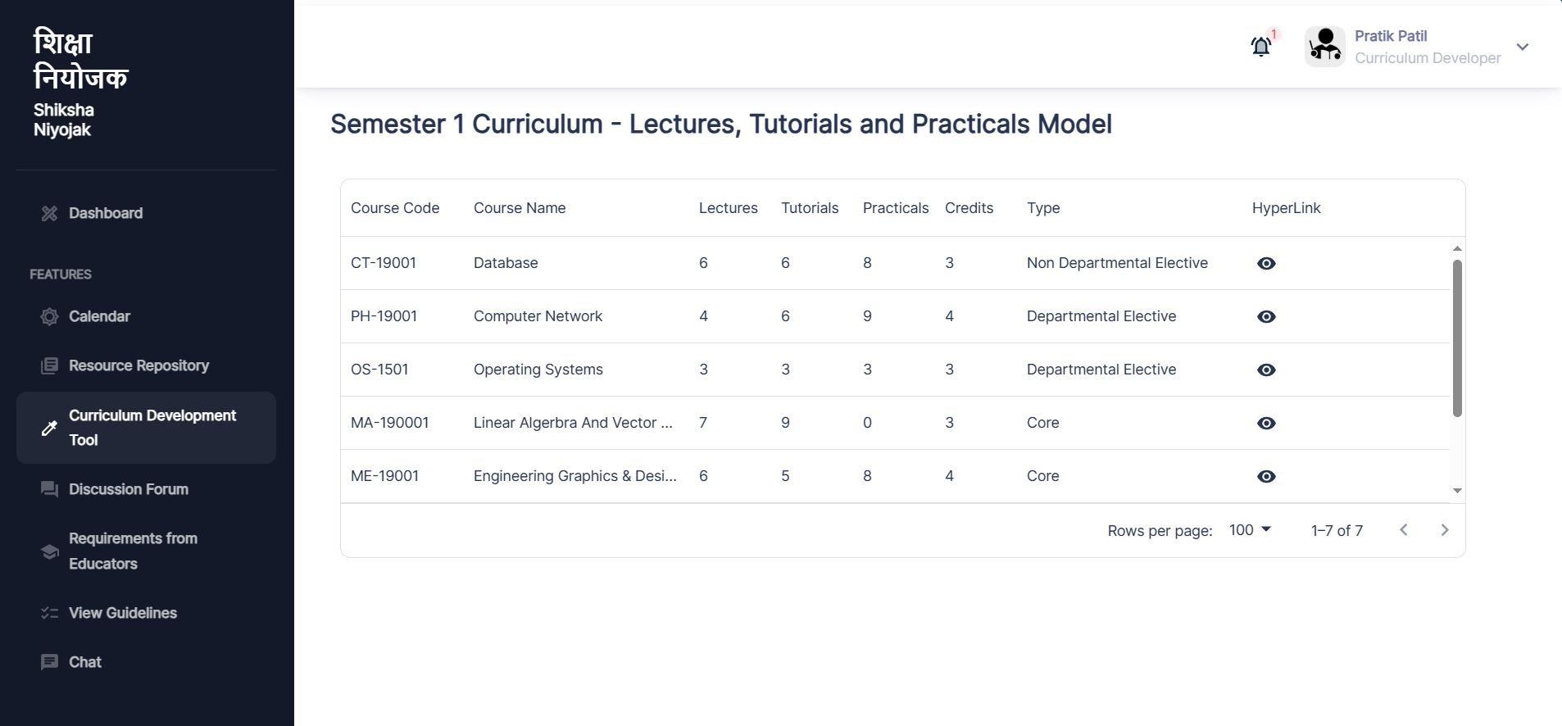
LTP Model

Slide 16
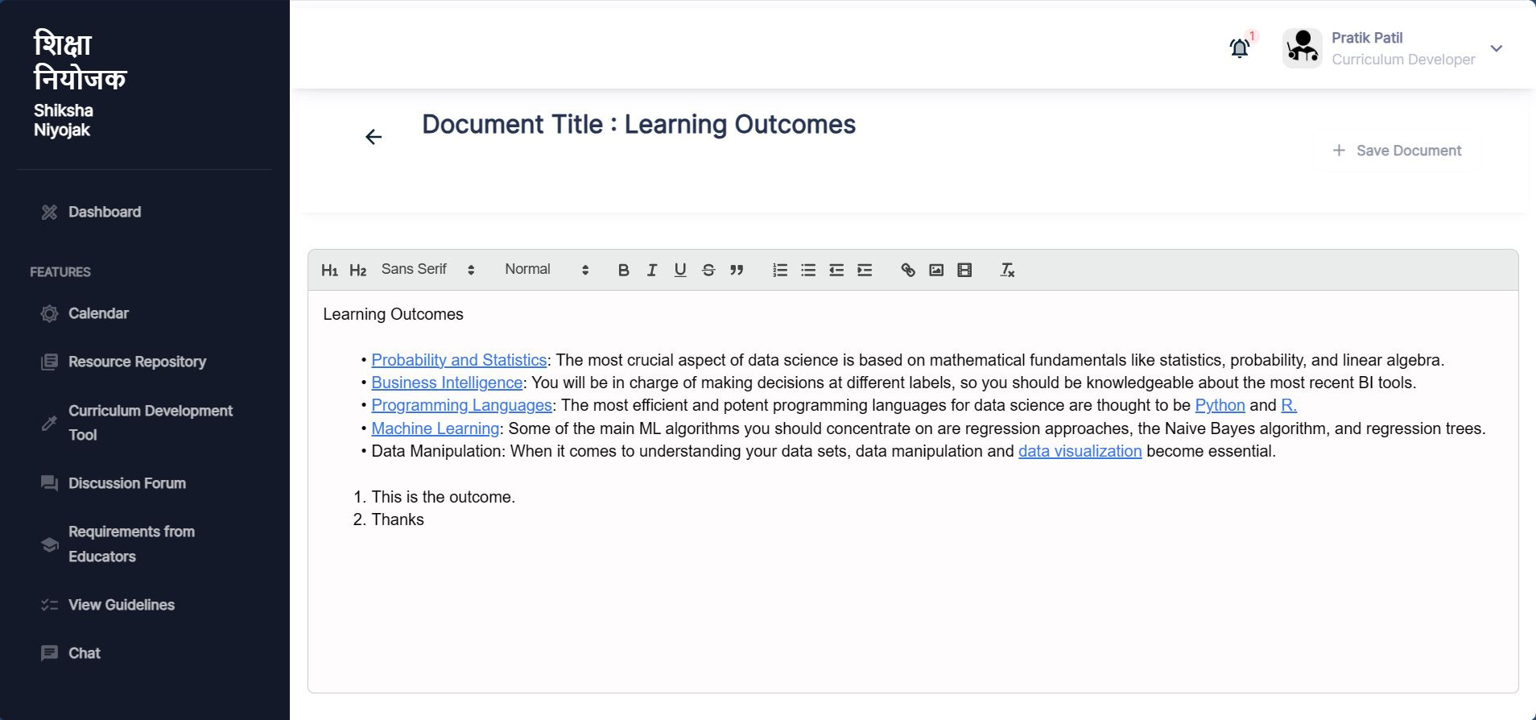
Curriculum Development Tool

Slide 17
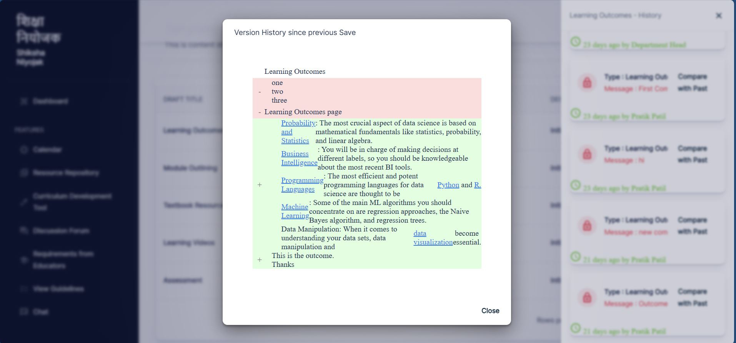
Version Control

Slide 18
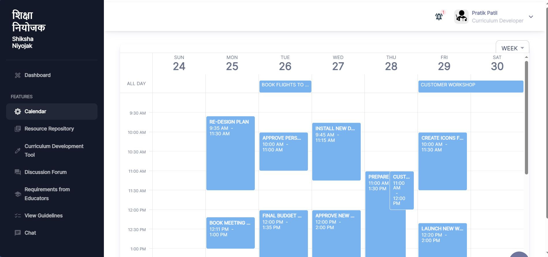
Calendar

Slide 19
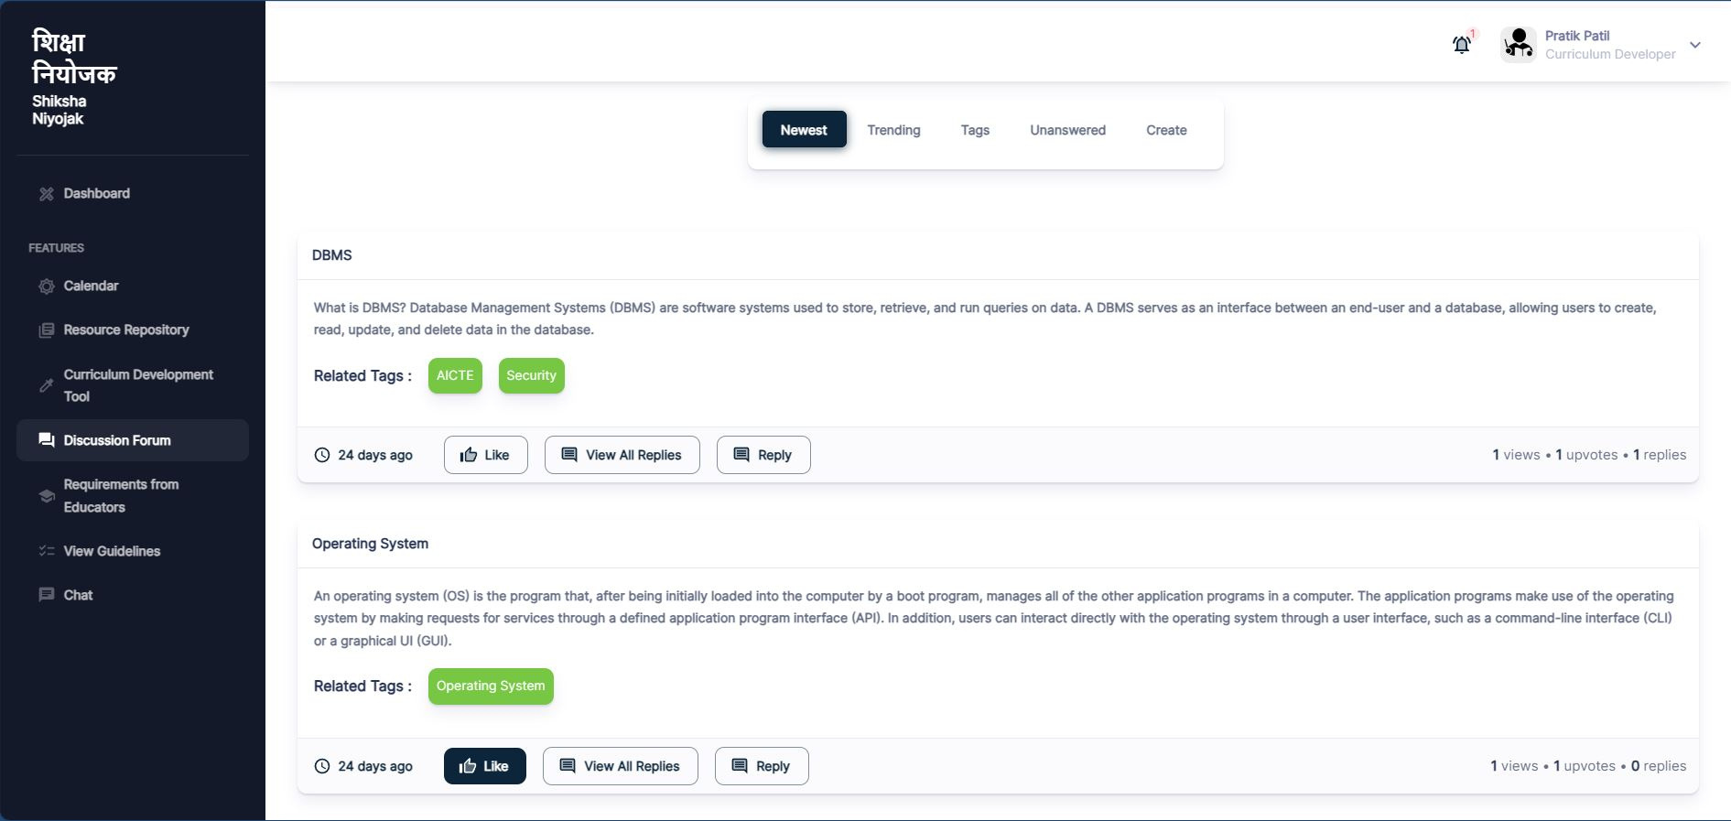
Discussion Forum

Slide 20

AICTE-Admin Pages
Feedback Analysis
Approve Curriculum Developer
Approve Curriculums
Appoint Bureau Heads
Add Educational Guidelines
Add Requirements

Slide 21
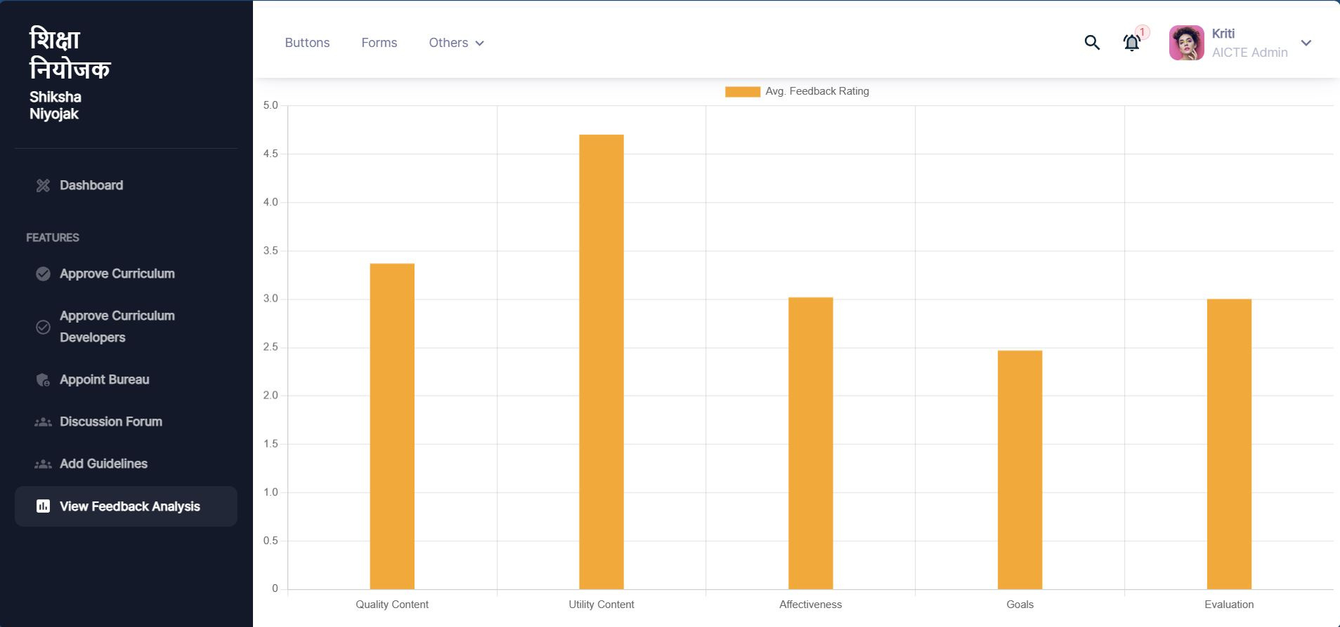
Feedback Analysis

Slide 22
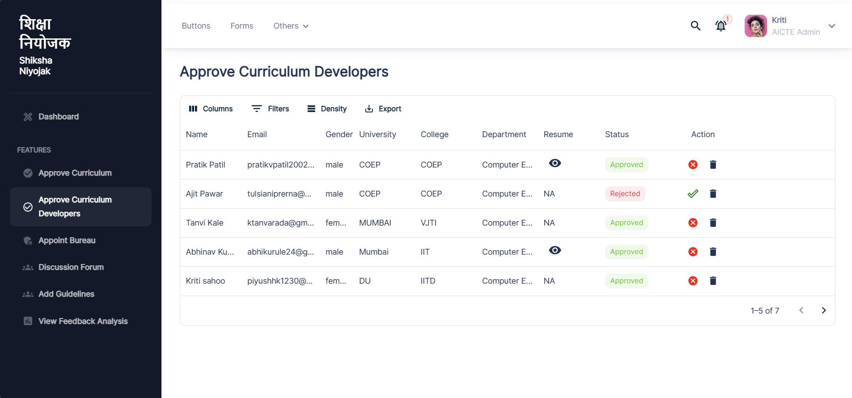
Approve Curriculum Developer

Slide 23
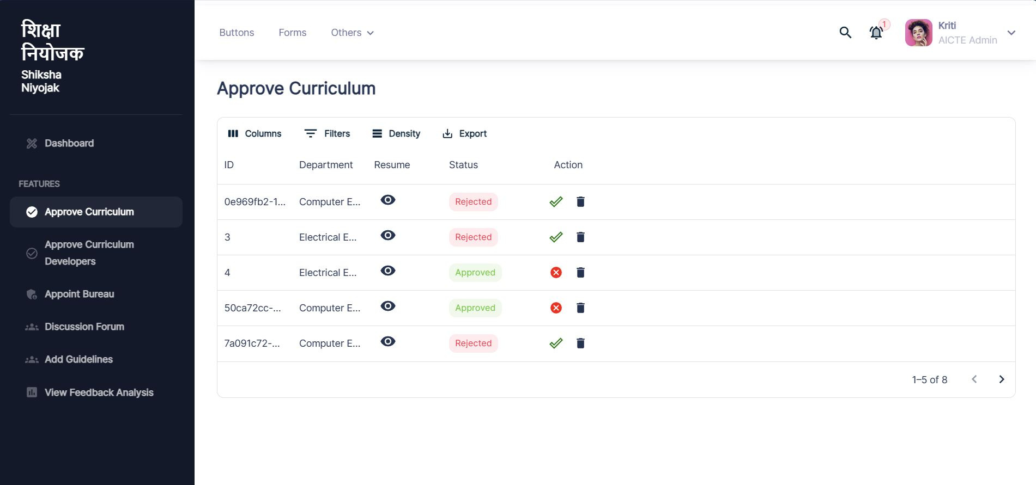
Approve Curriculums

Slide 24
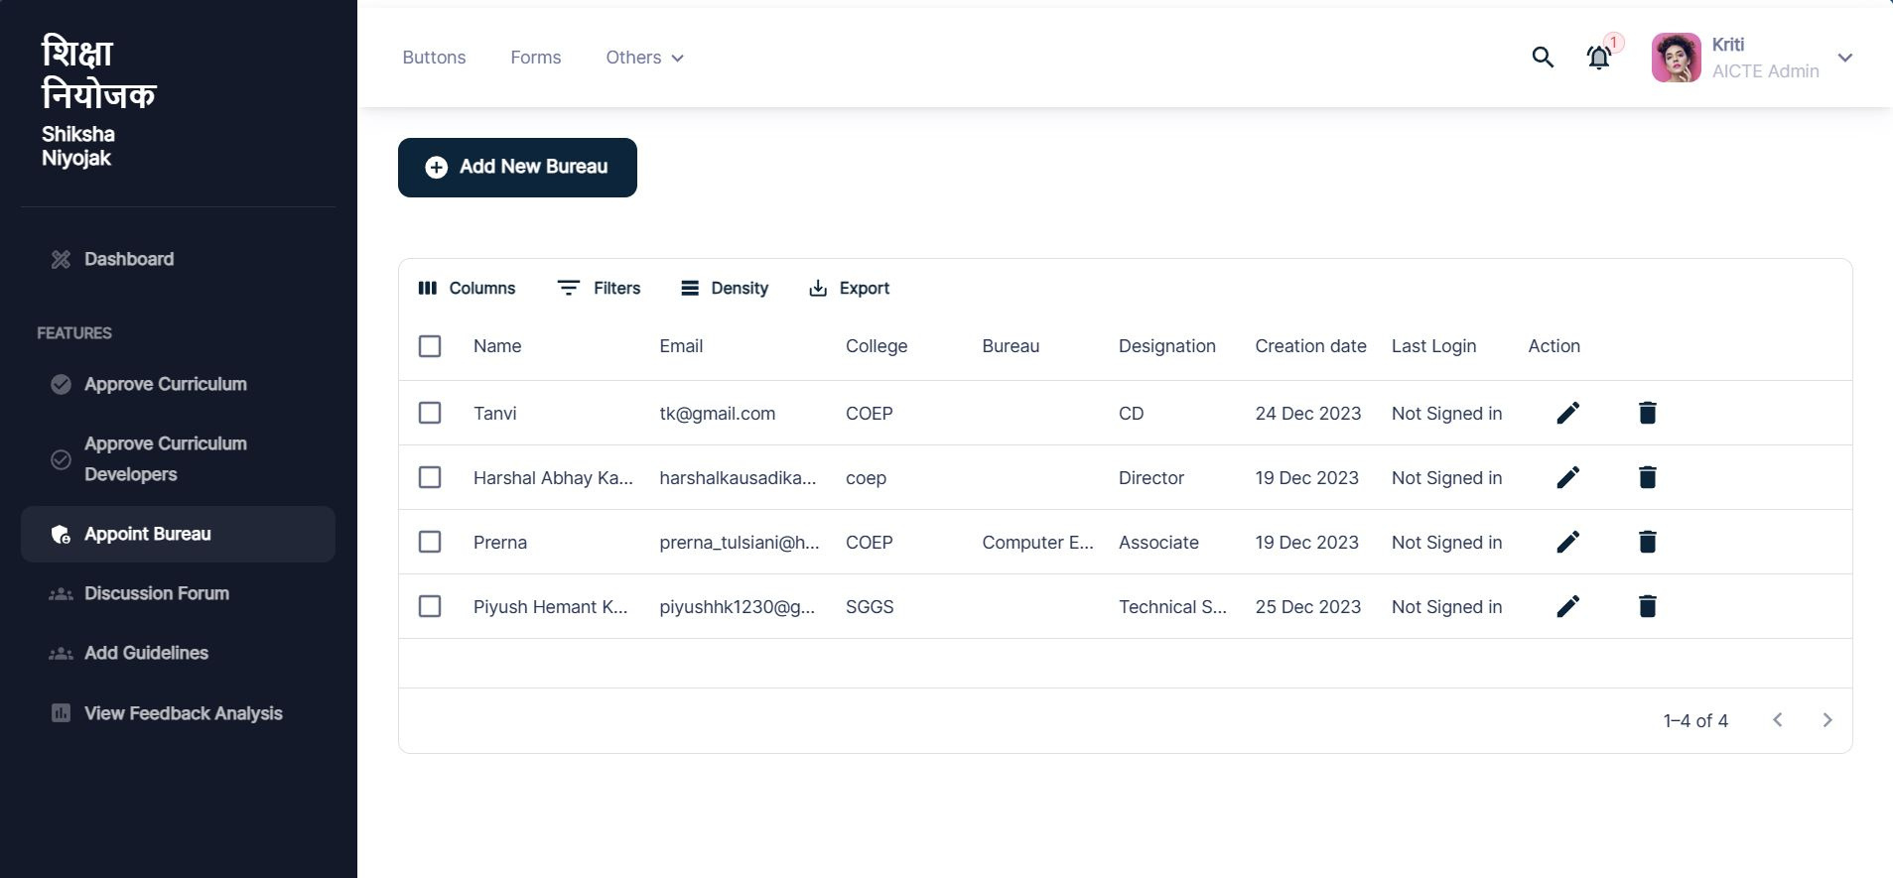
Appoint Bureau Heads

Slide 25
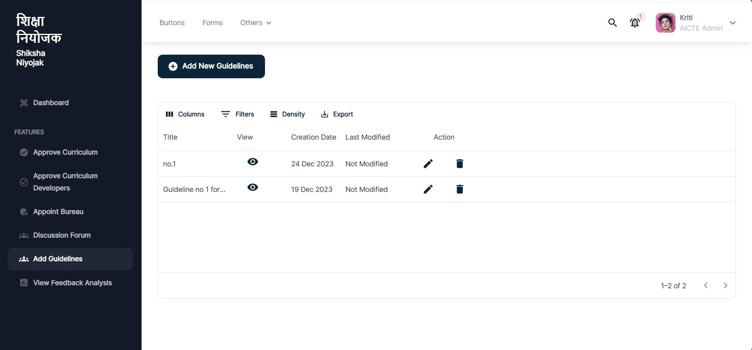
Add Educational Guidelines

Slide 26
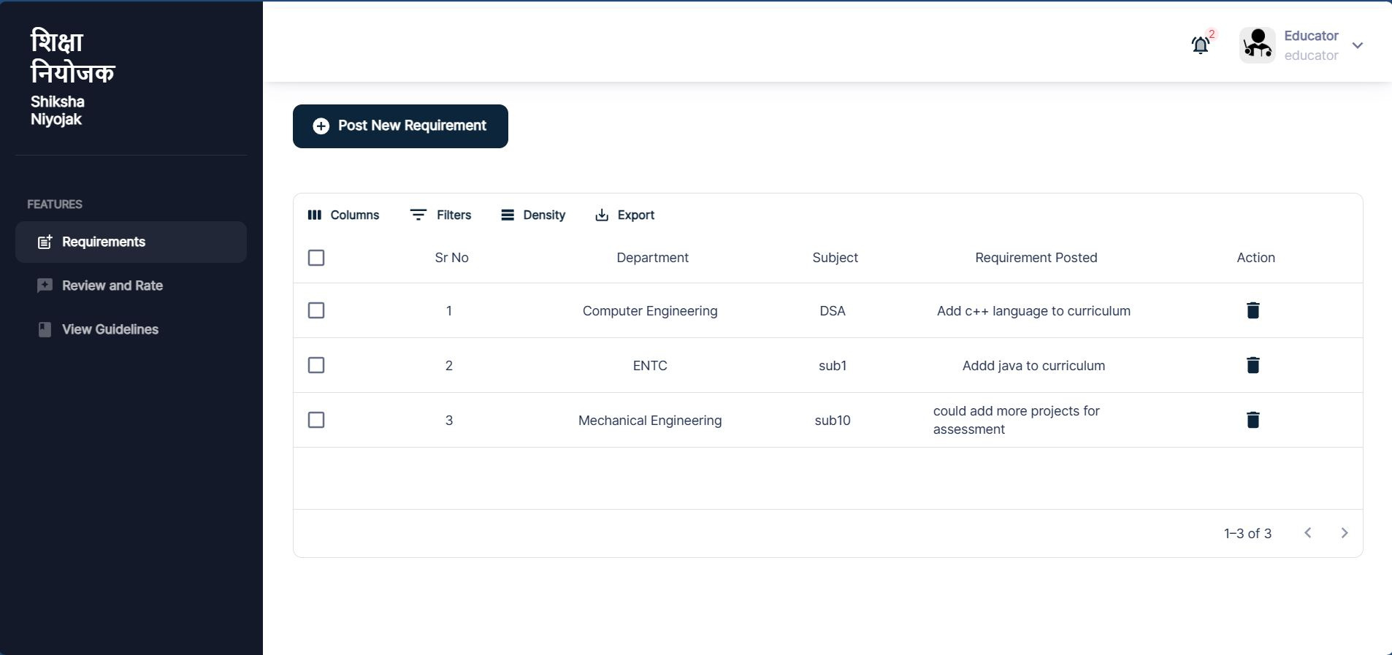
Add Requirements

Slide 27

Educator Pages
Rate and Review

Slide 28
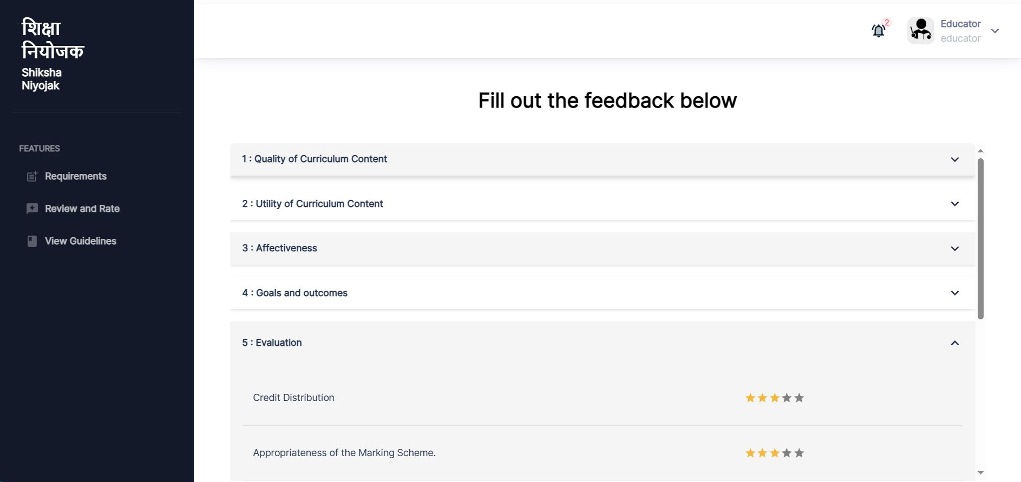
Rate and Review

Slide 29
Bureau Head Pages
View Curriculum Draft Status
Make changes in LTP Model
Subject Groups for their Bureau

Slide 30
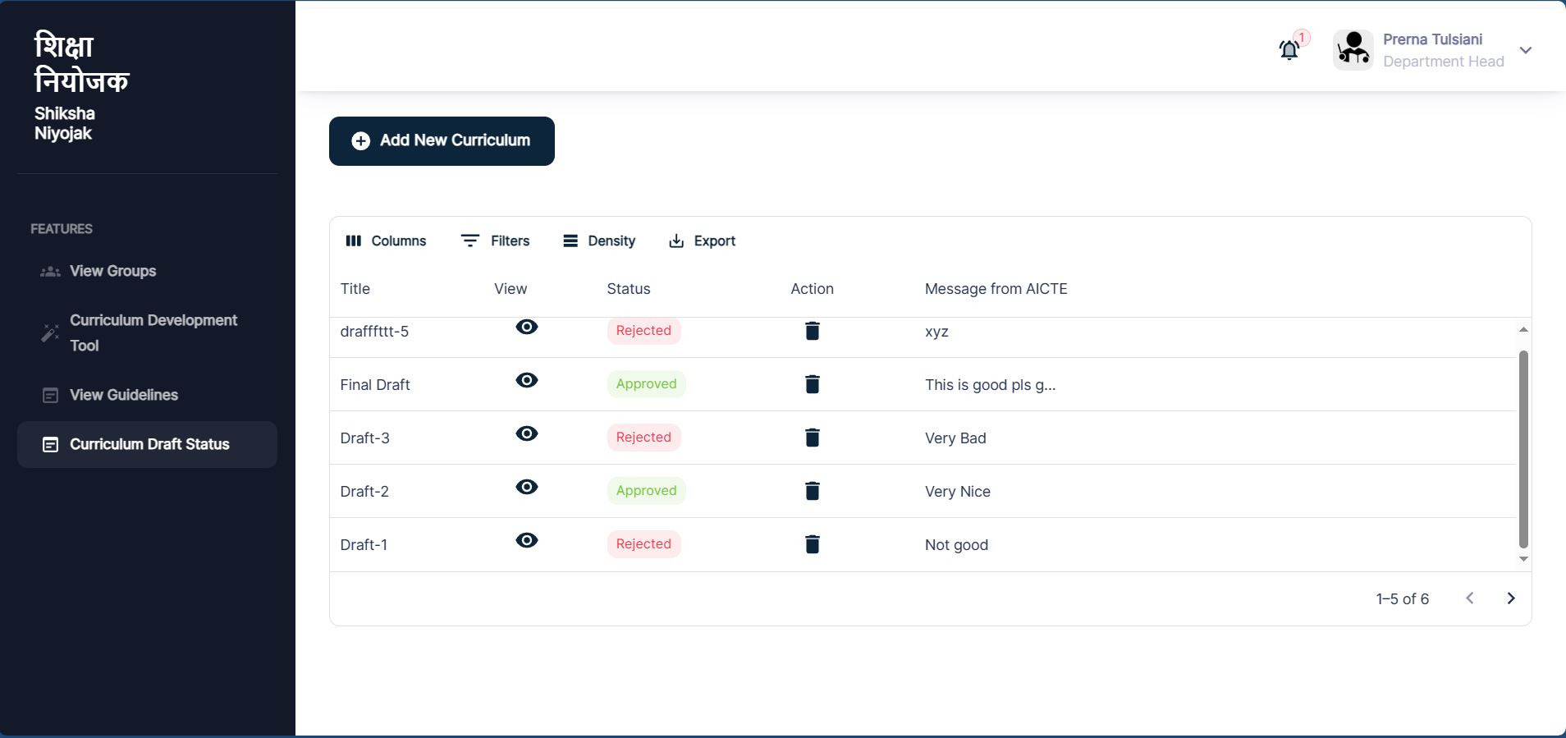
Curriculum Draft Status

Slide 31
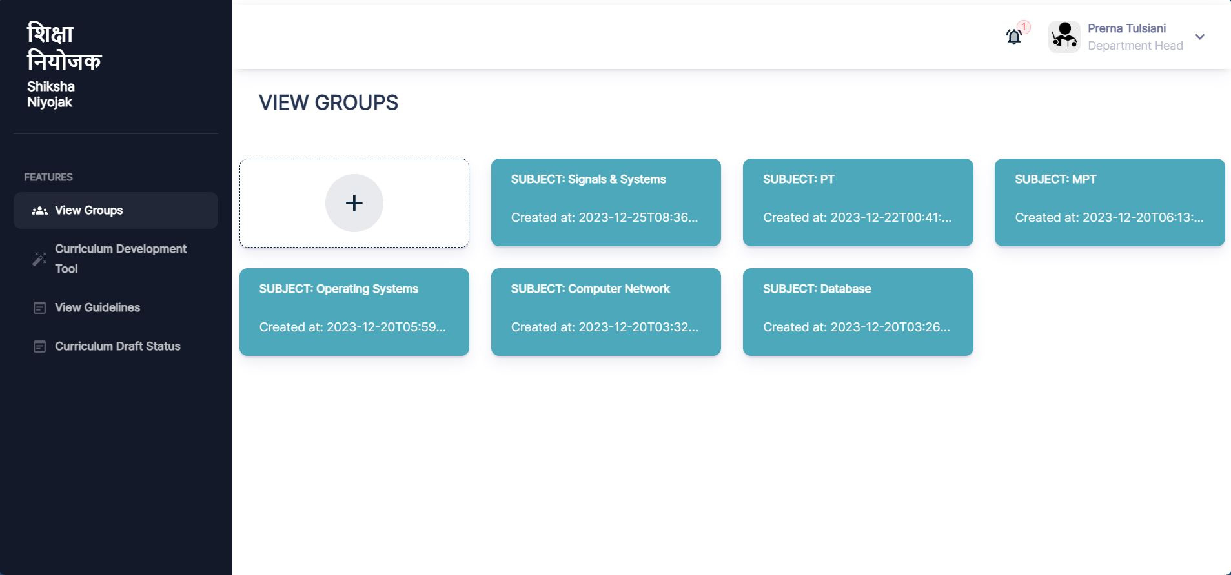
Subject Groups

Slide 32


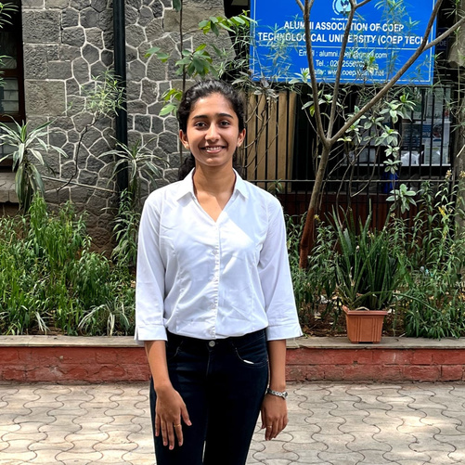



HexxCode Team
“The team of Hackathon would want to remain engaged in future to roll this out for AICTE”
College of Engineering Pune, Technological University (COEP Tech)
Prerna Tulsiani
Tanvi Kale
Jia Johnson
Harshal Kausadikar
Pratik Patil
Abhinav Kurule
Team Leader
Frontend
UI / UX
Backend
System Architect
AI / ML

